Slide 2
INTRODUCTION
Quora is a platform where people can ask their questions and get answers from different people, sometimes the questions asked may be asked in different format but the intent was the same
Ideally, what would happen is that once a question is asked, Quora would use some “technique” to find a subset of its existing question database such that this subset contains questions which are “similar” to or about the same topic as the new question being asked. Once this subset has been identified, Quora would employ a machine learning technique to then determine if a duplicate question exists in this selected subset.

Slide 3
PROBLEM STATEMENT:
Identify which questions on Quora are duplicate. This could be useful to instantly provide answers to questions that have already been answered. We are tasked with predicting whether a pair of questions are duplicates or not.

Slide 4
SOFTWARE & HARDWARE REQUIREMENTS :
Hardware Specification:
Processor – i5 or more
Hard Disk – 50 GB
Memory – Min 8GB RAM
Software Specification:
Operating System : Windows 7 or more
Language: Python
IDE : Jupyter Notebook

Slide 5
DATASET
A data set is a collection of data. In the case of tabular data, a data set corresponds to one or more database tables, where every column of a table represents a particular variable, and each row corresponds to a given record of the data set in question. The data set lists values for each of the variables, such as height and weight of an object, for each member of the data set. Data sets can also consist of a collection of documents or files.
We got this dataset from Kaggle Website which is best place to get predefined/developed datasets which are used in various machine learning problems

Slide 6
Reading the dataset from Kaggle:
To read the dataset we use Pandas Library in python which is used to read and analyse the dataset which are in CSV or
Excel Files.
Handling the Missing data:
If there is any missing data in the dataset we should handle them by filling them or dropping the missing values.
Pre-processing:
In this Step we will clean the data by using some python libraries like beautifulsoup, Stop words, for increasing the readability, In this step we will convert the Uppercase letters to Lower case and remove the HTML tags and all and helps in reducing the complexity in reading strings by converting strings into numerics.

Slide 7
FEATURE EXTRACTION:
Basic Features - Extracted some features before cleaning of data as below.
q1len = Length of q1
q2len = Length of q2
q1_n_words = Number of words in Question 1
q2_n_words = Number of words in Question 2
word_Common = (Number of common unique words in Question 1 and Question 2)
word_Total =(Total num of words in Question 1 + Total num of words in Question 2)
word_share = (word_common)/(word_Total)

Slide 8
Advanced Features:
Did some preprocessing of texts and extracted some other features. i am giving some definitions which are used below. Token- You get a token by splitting sentence by space , Stop_Word - stop words as per NLTK, Word -A token that is not a stop_word.
cwc_min = common_word_count / (min(len(q1_words), len(q2_words))
cwc_max = common_word_count / (max(len(q1_words), len(q2_words))
csc_min = common_stop_count / (min(len(q1_stops), len(q2_stops))
csc_max = common_stop_count / (max(len(q1_stops), len(q2_stops))
ctc_min = common_token_count / (min(len(q1_tokens), len(q2_tokens))
ctc_max = common_token_count / (max(len(q1_tokens), len(q2_tokens))
last_word_eq = Check if Last word of both questions is equal or not (int(q1_tokens[-1] == q2_tokens[-1]))
first_word_eq = Check if First word of both questions is equal or not (int(q1_tokens[0] == q2_tokens[0]) )
abs_len_diff = abs(len(q1_tokens) - len(q2_tokens))
mean_len = (len(q1_tokens) + len(q2_tokens))/2

Slide 9
Fuzzy Features:
fuzz_ratio = How much percentage these two strings are similar, measured with edit distance.
fuzz_partial_ratio = if two strings are of noticeably different lengths, we are getting the score of the best matching lowest length substring.
token_sort_ratio = sorting the tokens in string and then scoring fuzz_ratio.
longest_substr_ratio = len(longest common substring) / (min(len(q1_tokens), len(q2_tokens))
Feature Scaling:
It is a step of Data Pre Processing that is applied to independent variables or features of data.It basically helps to normalize All the data within a particular range, so that each and every data in same Range.
Word2vec:
Convert a collection of text documents to a matrix of token counts.
This implementation produces a sparse representation of the counts using genism.model import woed2vec.

Slide 10
Machine Learning Models
We Applied Some Machine Learning Classification Models to Solve the Quora Question Pair similarity Problem, They are:
Decision Tree
Random Forest Classifier
Logistic Regression Classifier
XGboost

Slide 11
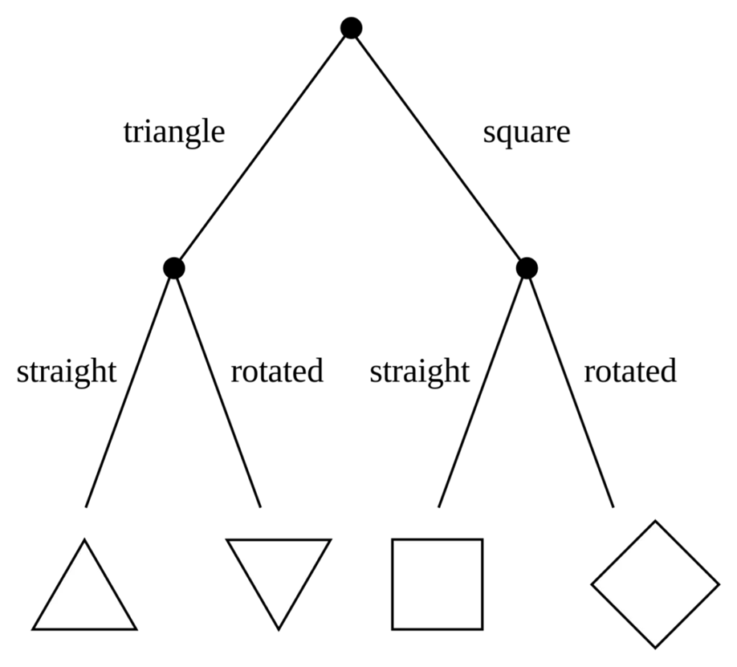
Decision Tree
It is process of choosing course of action from among alternatives to achieve a desired goal.
It is a graphical representation of possible solutions to a decision based on certain conditions.
it starts with a single root which then branches off into a number of solutions just like tree.
Advantages:
These are simple to understand and interpret.
these are very fast and efficient.
The data type of decision tree can handle any type of data whether it is numerical or categorical, or boolean.
Normalization is not required in the Decision Tree.
It can be used in Both Classification and Regression Models.

Slide 12

Random Forest Classifier
Random forest is a Supervised Machine Learning Algorithm that is used widely in Classification and Regression problems.
It builds decision trees on different samples and takes their majority vote for classification and average in case of regression.
Advantages:
It can be used in classification and regression problems.
It solves the problem of overfitting as output is based on majority voting or averaging.
It performs well even if the data contains null/missing values.
Each decision tree created is independent of the other thus it shows the property of parallelization.
It is highly stable as the average answers given by a large number of trees are taken.
We don’t have to segregate data into train and test as there will always be 30% of the data which is not seen by the decision tree made out of bootstrap.

Slide 13
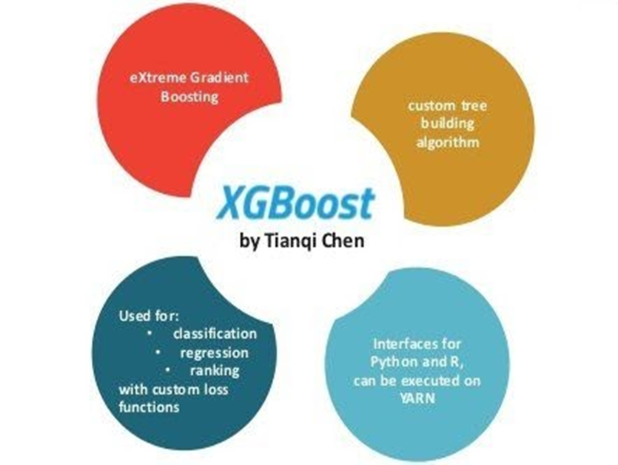
XGBOOST
XGBoost is an optimized distributed gradient boosting library designed to be highly efficient, flexible and portable. It implements machine learning algorithms under the Gradient Boosting framework. XGBoost provides a parallel tree boosting that solve many data science problems in a fast and accurate way.
Advantages:
It is Highly Flexible
It uses the power of parallel processing
It is faster than Gradient Boosting
It supports regularization.
It is designed to handle missing data with its in-build features.
The user can run a cross-validation after each iteration.
It Works well in small to medium dataset

Slide 14
Results
Models | Accuracy Score
Decision Tree | 80.35%
Random Forest | 80.35%
XGBoost | 79.7%

Slide 15
Our Research
Fuzzy logic
Word2vec
Named-entity recognition(NER)
TF-IDF (Term Frequency-Inverse Document Frequency)
Bag of Words (BOW)
BERT (Bidirectional Encoder Representations from Transformers)

Slide 16
Fuzzy logic
Fuzzy logic is an approach to variable processing that allows for multiple possible truth values to be processed through the same variable.
In traditional logic, a statement is either true or false, but in fuzzy logic, a statement can have a degree of truth that ranges from 0 to 1, where 0 represents "completely false," 1 represents "completely true," and values in between represent degrees of truth such as "high," "low," "medium," "very," and "somewhat.“
Like for our project Quora Question Pair Similarity problem we are using fuzz ratio, fuzz partial ratio , token sort ratio, token set ratio. d "somewhat.“

Slide 17
Word2vec
Word2Vec is a state of the art algorithm to generate fixed length distributed vector representation of all the words in huge corpus.
The effectiveness of Word2Vec is due two reasons . One, the use of fixed size vectors which means the vector size does not depend on the number of unique words in the corpus.
Second, incorporating semantic information in the vector representations. Word2Vec vectors are highly efficient at grouping similar words together
For example, ”Kid” and “Child” are similar and hence their vector representation will be very similar.
Word2Vec can be implemented in two architectures — Continuous Bag of Words(CBOW) and Skip-Gram. The main idea of Word2Vec revolves around predicting the context (outside) words based on a center word or vice versa in a fixed size window.
The features allowed are pre-fixed.

Slide 18
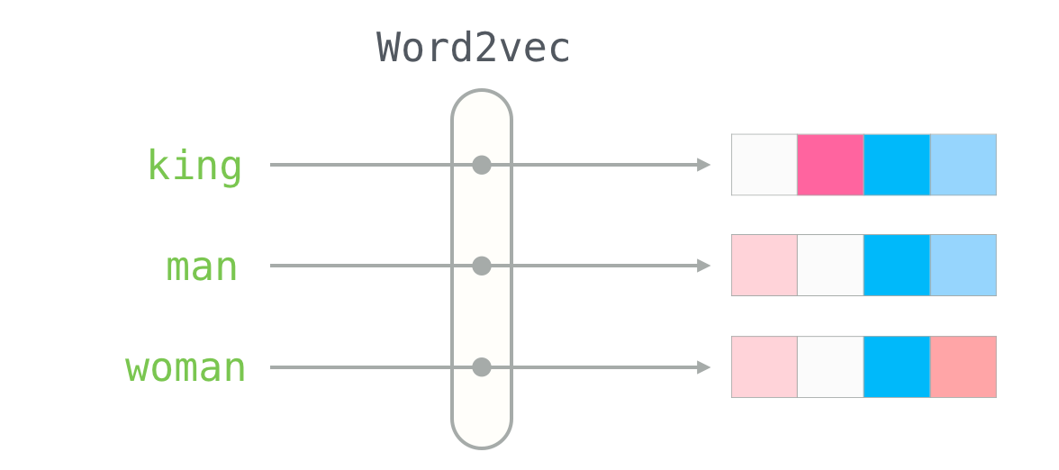
Color Codes .Vectors Generated by Word2Vec model . As we can see MAN and WOMEN vectors are appearing same. Hence, maintaining the Semantics of the string.

Slide 19
Name entity recognization (NER)
It involves the identification of key information in the text and classification into a set of predefined categories.
At its core, NLP is just a two-step process, below are the two steps that are involved:
Detecting the entities from the text.
Classifying them into different categories.

Slide 20
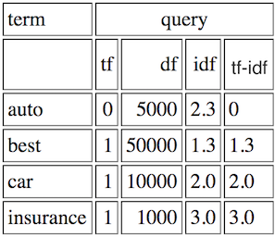
TF-IDF (Term Frequency-Inverse Document Frequency)
We compute a score for each word for signify its importance in an document and corpus .
The TF-IDF score of a term is calculated by multiplying its term frequency (TF) and inverse document frequency (IDF) values
The formula for calculating the TF-IDF score of a term is:
TF-IDF = TF * IDF
TF (Term Frequency) = (Number of times the term appears in a document) / (Total number of terms in the document)
IDF (Inverse Document Frequency) = log (Total number of documents / Number of documents containing the term)

Slide 21
Bag of Words (BOW)
In natural language processing (NLP), the "bag of words" model is a way of representing text data as a collection of individual words, disregarding grammar and word order but considering their frequency in the text.
The bag of words model works by first identifying all the unique words in a text document and then creating a vector for each document that counts the occurrence of each unique word. These vectors can be used as input to machine learning models for various NLP tasks, such as text classification, sentiment analysis, and information retrieval.
The bag of words model has some limitations. It does not take into account the meaning of the words, the context in which they appear, or the relationships between them. This can lead to ambiguity and loss of information. However, it is a simple and effective way of representing text data that can be useful in many NLP applications.

Slide 22
Example of BOW
For example, consider the following two sentences:
"The cat is on the mat.“
"The dog is on the bed."
To represent these sentences using the bag of words model, we would first identify all the unique words: "the", "cat", "is", "on", "mat", "dog", "bed". Then we would count the number of times each word appears in each sentence and create vectors:
Sentence 1: [1, 1, 1, 1, 1, 0, 0]
Sentence 2: [1, 0, 1, 1, 0, 1, 1]
In these vectors, the first element represents the count of "the", the second represents the count of "cat", and so on. Note that the word "is" appears in both sentences but has different counts.

Slide 23
BERT (Bidirectional Encoder Representations from Transformers)
It is a pre-trained natural language processing (NLP) model developed by Google.
It is a neural network-based technique that uses the Transformer architecture to learn contextual relations between words in a text corpus.
BERT is trained on a large corpus of unlabeled text data, such as Wikipedia articles, books, and web pages, using a masked language modeling (MLM) approach.
BERT is used in a wide range of NLP tasks such as sentiment analysis, question answering, named entity recognition, and text classification.

Slide 24
Conclusion
In this Project, The Quora Question Pair dataset is used to predict the similarity between the two questions for duplicity using Machine Learning Algorithms. before applying Machine Learning Models we done the Preprocessed the dataset and applied some models and we got the results as below mentioned.
By seeing the above table we can conclude that Random Forest classifier is the efficient among all other Classification Models with an accuracy of 80.35%, followed by XGBoost classifier with 79.7%, Decision Tree with 80.35% and Logistic Regression Classifier with 71%

Slide 25
References
Rishickesh Ramesh, R.P Ram Kumar, A. Shahina, Dr. A. Nayeemulla Khan “Identification of Duplication in Questions Posed on Knowledge Sharing Platform Quora using Machine Learning Techniques” IJITEE Journal Paper
AINAB IMTIAZ, MUHAMMAD UMER, MUHAMMAD AHMAD, SALEEM ULLAH, GYU SANG CHOI, ARIF MEHMOOD “Duplicate Questions Pair Detection Using Siamese MaLSTM”, IEEE Journal Paper
Logistic Regression classifier “https://www.geeksforgeeks.org/advantages-and-disadvantages-of-logistic-regression/”
Random Forest “https://www.analyticsvidhya.com/blog/2021/06/understanding-random-forest”
Decision Tree “https://www.slideshare.net/DakshGoyal3/decision-tree-69802132”
XG Boost Classifier “https://analyticsindiamag.com/xgboost-internal-working-to-make-decision-trees-and-deduce-predictions”
https://github.com/UdiBhaskar/Quora-Question-pair-similarity
https://www.kaggle.com/code/veerpalsingh/quora-question-pair-final
https://github.com/campusx-official/quora-question-pairs/blob/main/bow-with-preprocessing-and-advanced-features.ipynb
Chatgpt

